Slide 1
Astro 331 Lesson 15
Communications Architecture
SMAD Ch 13.1, 13.3, 13.5.3, Supp Crs Mtl

Slide 2
Lesson Objectives
Label the pieces in a satellite communications architecture (i.e. uplink, downlink, forward link, return link, crosslink, relay satellite)
Describe the difference between point-to-point and broadcast communications architectures
List and describe the criteria for selecting a communications architecture
Perform link analysis calculations in real numbers and decibels
Understand the sources of noise in a link budget
Understand what jamming is and some techniques to reduce its effects

Slide 3
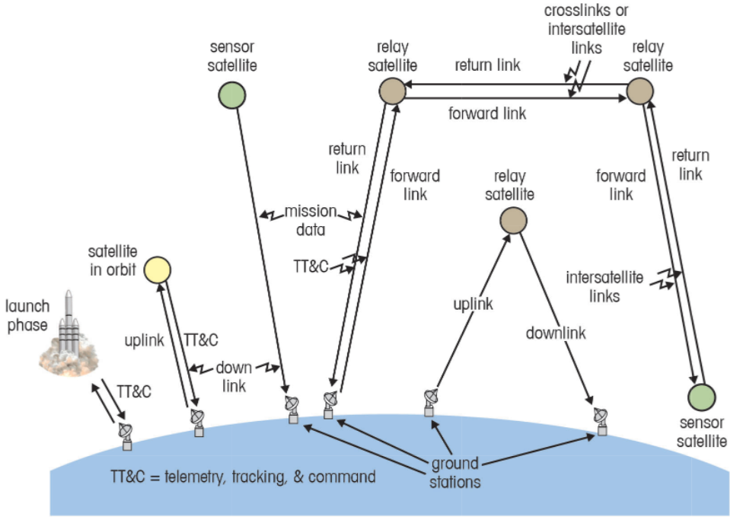
Fig 13-1 The Communications Architecture Consists of Satellites and Ground Stations Interconnected with Communications Links

Slide 4
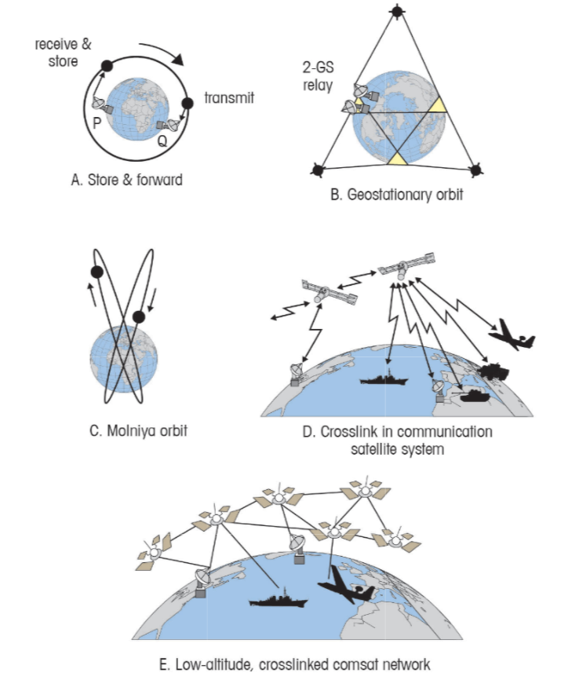
Fig 13-2 Typical Communications Architectures Used to Satisfy Different Mission Requirements

Slide 5
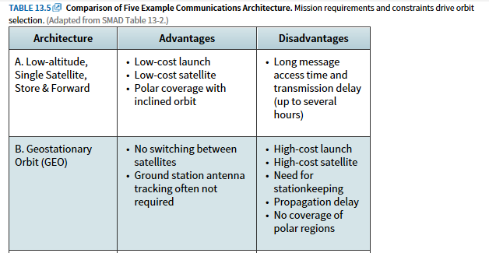
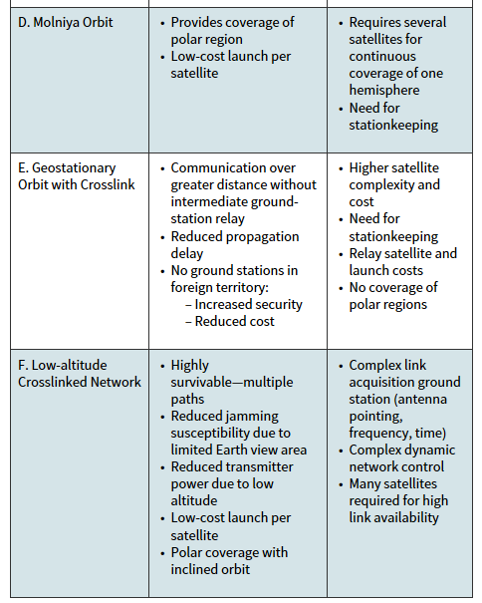

Slide 6
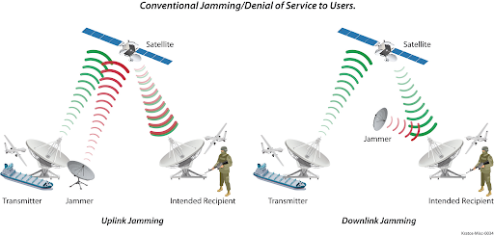
Figure from https://www.worldteleport.org/news/442460/DoDs-Automated-Satellite-Roaming-How-the-technology-protects-against-denial-of-satellite-services.htm

Slide 7
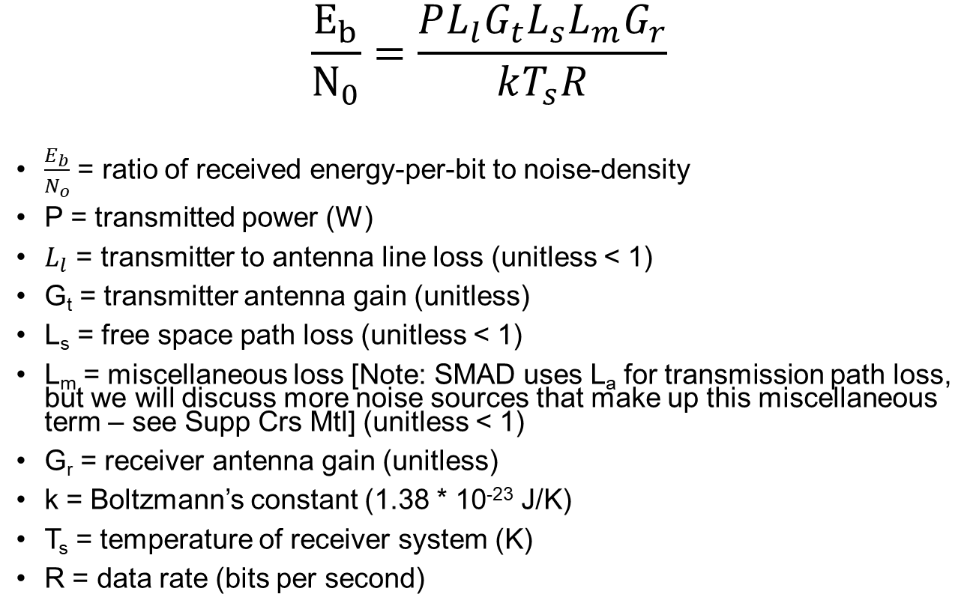
Link Budgets & Noise Sources
$$\frac{E_{b}}{N_{0}}=\frac{PL_{l}G_{t}L_{s}L_{m}G_{r}}{kT_{s}R}$$
$\frac{E_{b}}{N_{o}}$ = ratio of received energy-per-bit to noise-density
P = transmitted power (W)
$L_{l}$ = transmitter to antenna line loss (unitless < 1)
G_{t} = transmitter antenna gain (unitless)
L_{s} = free space path loss (unitless < 1)
L_{m} = miscellaneous loss [Note: SMAD uses L_{a} for transmission path loss, but we will discuss more noise sources that make up this miscellaneous term – see Supp Crs Mtl] (unitless < 1)
G_{r} = receiver antenna gain (unitless)
k = Boltzmann’s constant (1.38 * 10⁻²³ J/K)
T_{s} = temperature of receiver system (K)
R = data rate (bits per second)

Slide 8
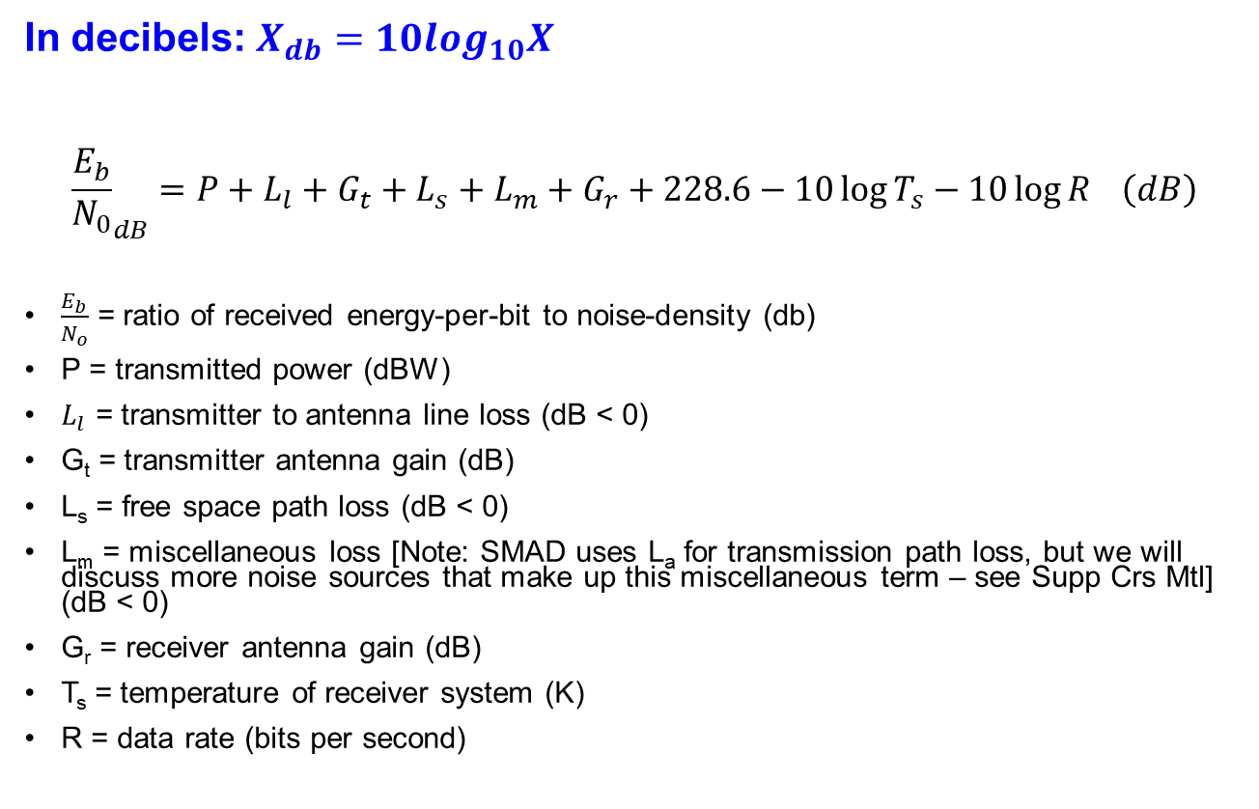
Link Budget in Decibels
In decibels: $X_{db}=10\log_{10}X$
$${\frac{E_{b}}{N_{0}}}_{dB}=P+L_{l}+G_{t}+L_{s}+L_{m}+G_{r}+228.6−10\log{T_{s}}−10\log{R} \left(dB\right)$$
$\frac{E_{b}}{N_{o}}$ = ratio of received energy-per-bit to noise-density (db)
P = transmitted power (dBW)
$L_{l}$ = transmitter to antenna line loss (dB < 0)
G_{t} = transmitter antenna gain (dB)
L_{s} = free space path loss (dB < 0)
L_{m} = miscellaneous loss [Note: SMAD uses L_{a} for transmission path loss, but we will discuss more noise sources that make up this miscellaneous term – see Supp Crs Mtl] (dB < 0)
G_{r} = receiver antenna gain (dB)
T_{s} = temperature of receiver system (K)
R = data rate (bits per second)

Slide 9
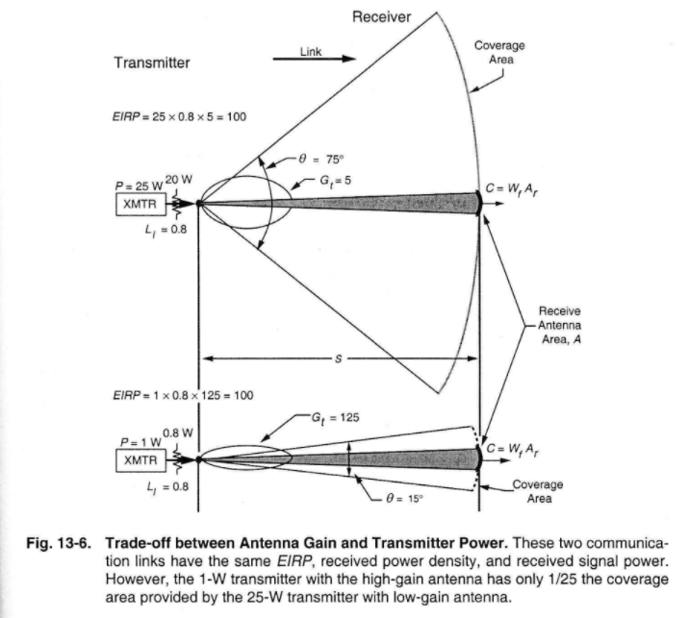
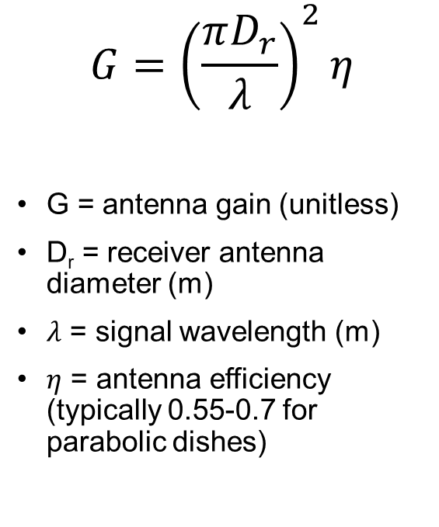
Antenna Gain
$$G={\left(\frac{πD_{r}}{λ}\right)}^{2}η$$
G = antenna gain (unitless)
D_{r} = receiver antenna diameter (m)
$λ$ = signal wavelength (m)
$η$ = antenna efficiency (typically 0.55-0.7 for parabolic dishes)

Slide 10
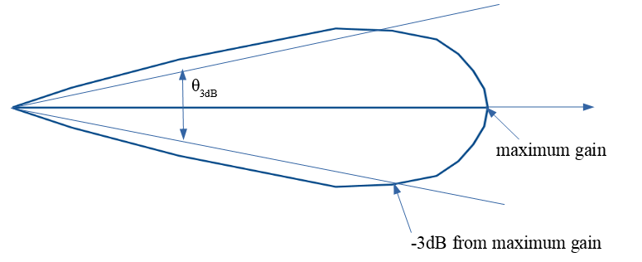
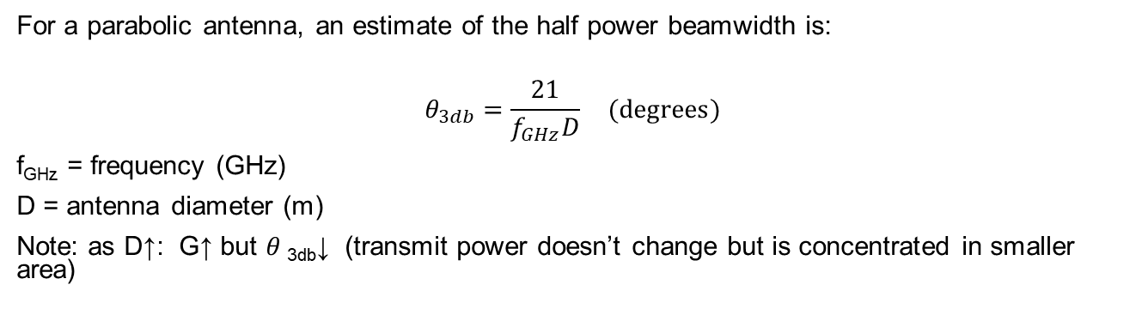
Antenna Beamwidth
For a parabolic antenna, an estimate of the half power beamwidth is:
$$θ_{3db}=\frac{21}{f_{GHz}D} (degrees)$$
f_{GHz} = frequency (GHz)
D = antenna diameter (m)
Note: as D↑: G↑ but $θ$_{3db}↓ (transmit power doesn’t change but is concentrated in smaller area)

Slide 11
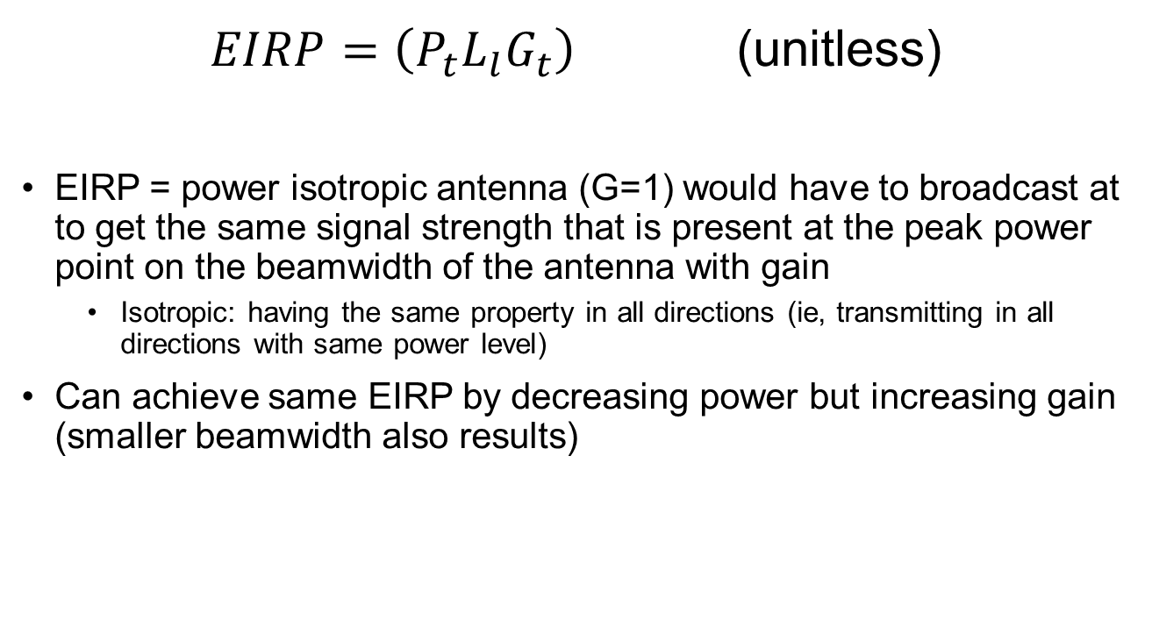
Effective Isotropic Radiated Power (EIRP)
$EIRP=\left(P_{t}L_{l}G_{t}\right)$ (unitless)
EIRP = power isotropic antenna (G=1) would have to broadcast at to get the same signal strength that is present at the peak power point on the beamwidth of the antenna with gain
Isotropic: having the same property in all directions (ie, transmitting in all directions with same power level)
Can achieve same EIRP by decreasing power but increasing gain (smaller beamwidth also results)

Slide 12
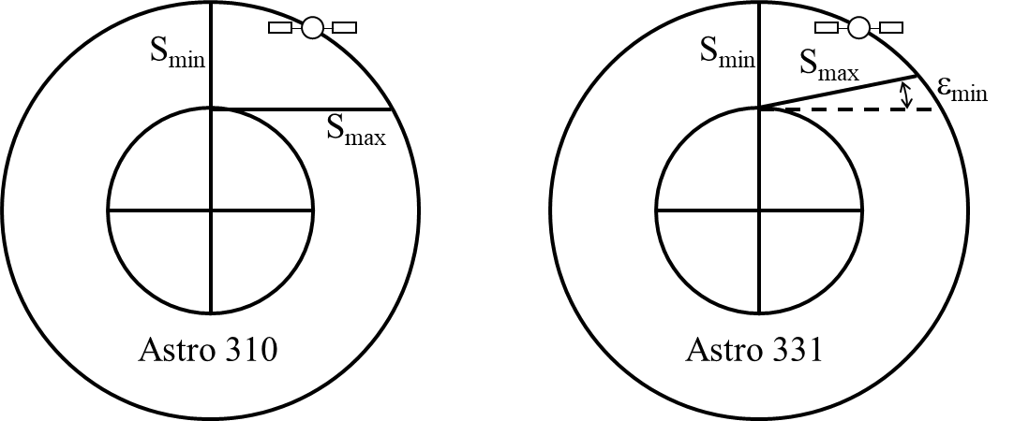
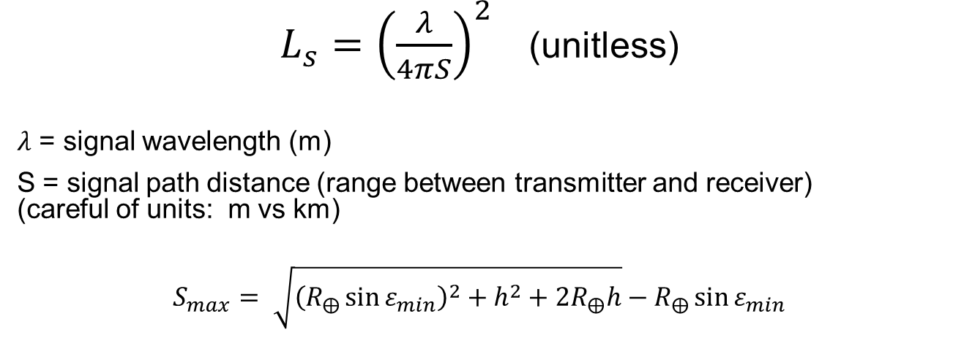
Free Space Path Loss, L_{s}
$L_{s}={\left(\frac{λ}{4πS}\right)}^{2}$ (unitless)
$λ$ = signal wavelength (m)
S = signal path distance (range between transmitter and receiver) (careful of units: m vs km)
$$S_{max}= \sqrt{{\left(R_{⨁}\sin{ε_{min}}\right)}^{2}+h^{2}+2R_{⨁}h}−R_{⨁}\sin{ε_{min}}$$

Slide 13
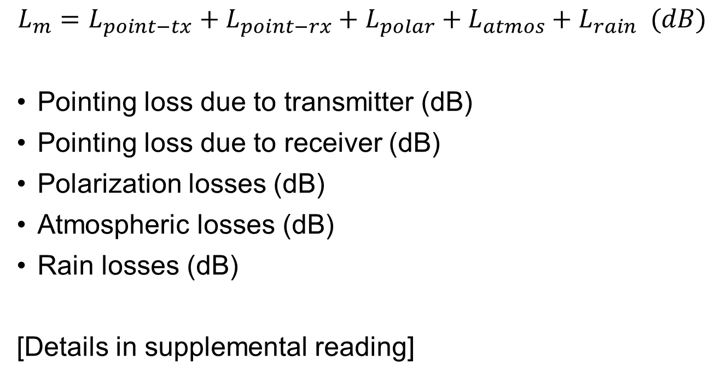
Miscellaneous Losses, L_{m}
$$L_{m}=L_{point−tx}+L_{point−rx}+L_{polar}+L_{atmos}+L_{rain} (dB)$$
Pointing loss due to transmitter (dB)
Pointing loss due to receiver (dB)
Polarization losses (dB)
Atmospheric losses (dB)
Rain losses (dB)
[Details in supplemental reading]

Slide 14

Antenna Pointing Loss, L_{point}
$$L_{point}=−12{\left(\frac{e}{θ_{3dB}}\right)}^{2} (dB)$$
e = off-axis pointing error (angle in degrees)

Slide 15

Polarization Mismatch Loss, L_{polar}
$L_{polar}=\cos^{2}{θ}$ (unitless)
L_{polar} = linear polarization loss (for vertical or horizontal polarized signals but not left or right handed circular polarized)
$θ$ = misalignment angle btw transmit and receive antennas

Slide 16
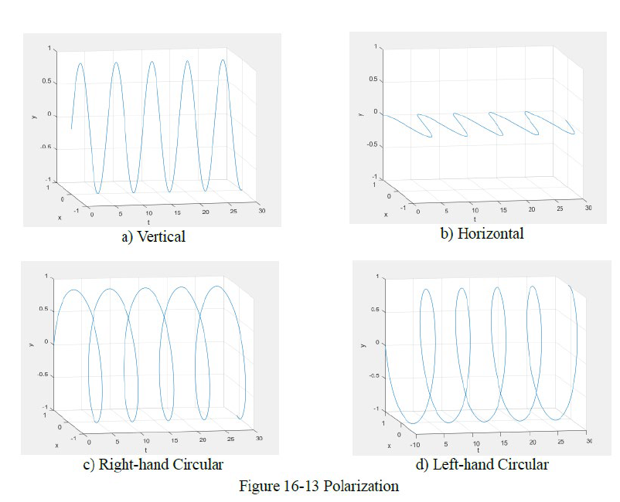

Slide 17
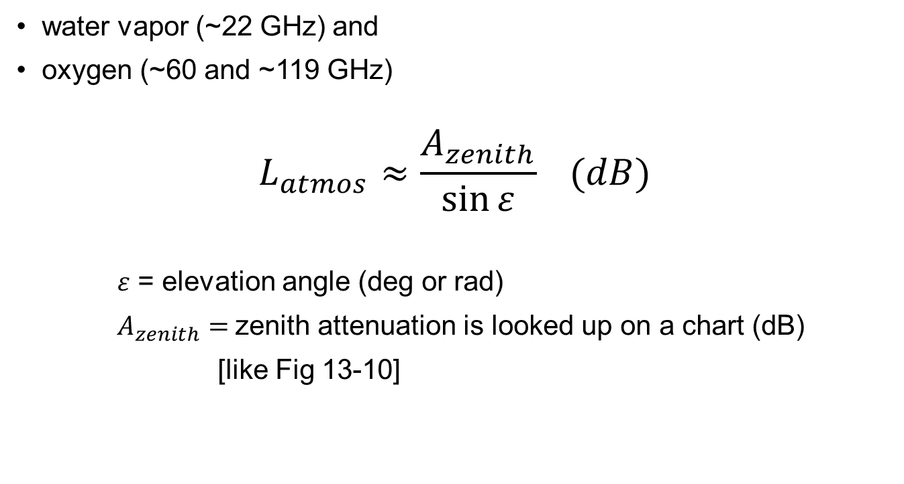
Atmospheric Loss
water vapor (~22 GHz) and
oxygen (~60 and ~119 GHz)
$$L_{atmos}≈\frac{A_{zenith}}{\sin{ε}} (dB)$$
$ε$ = elevation angle (deg or rad)
$A_{zenith}=$zenith attenuation is looked up on a chart (dB)
[like Fig 13-10]
*Note: Atmospheric loss must be used as a NEGATIVE dB because it’s a loss!

Slide 18
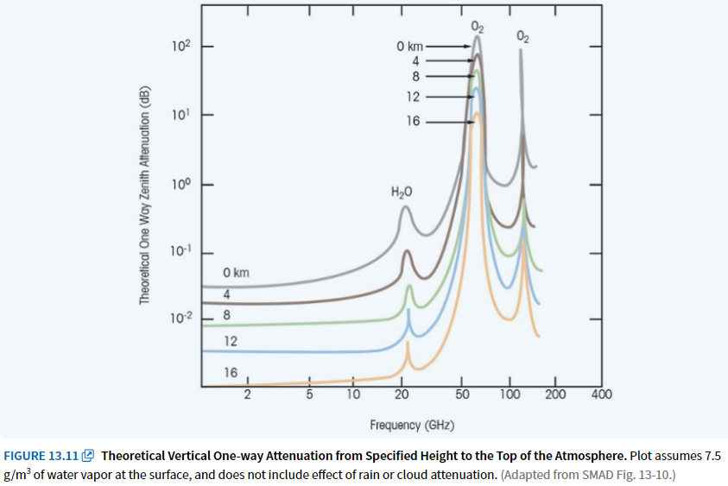
One-way Zenith Attenuation

Slide 19
Rain Loss, L_{rain}
Frequency | L_{r}
f < 6 GHz | 0 dB
6 GHz < f < 18 GHz | -7 dB
f > 18 GHz | loss of link

Slide 20
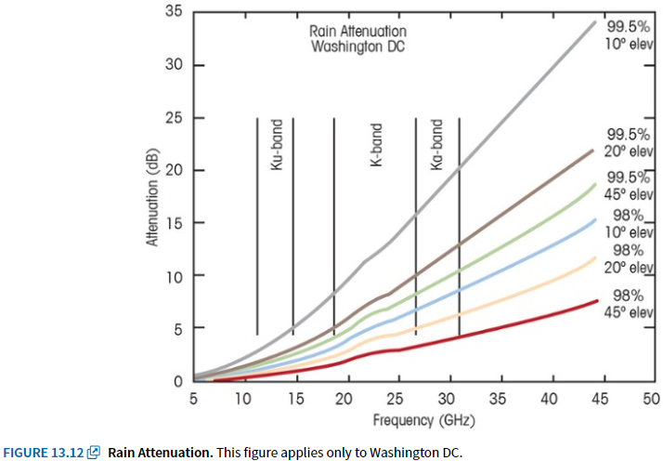
Rain Attenuation (Washington, DC)
Similar to Fig 13-11 for Rain Attenuation

Slide 21
Example
For the following parameters, you may assume a circular orbit and parabolic dishes for both transmit and receive.
Find: E_{b}/N₀

Slide 22
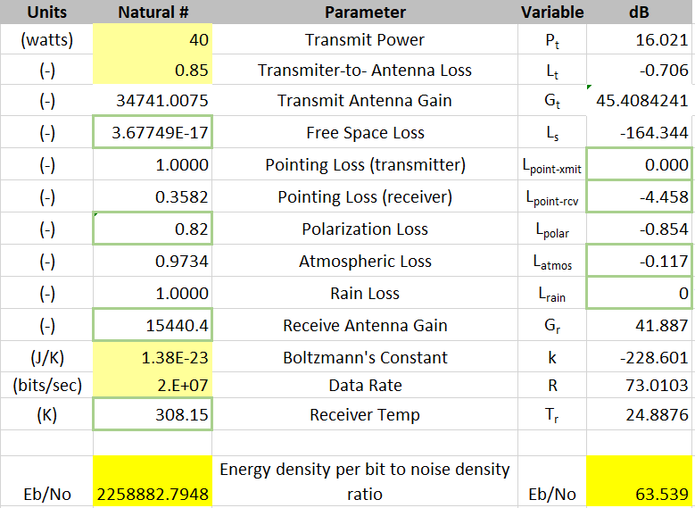
Answer
Answer
E_{b}/N₀ = 2,258,882.795 (unitless)
E_{b}/N₀ (dB) = 63.539 dB
This is very large. We typically would like to see E_{b}/N₀ > 9 dB, so this link has tons of margin. However, 4-meter and 6-meter dishes are much larger than what we typically have on spacecraft. The pointing error values here are also quite small (which means very precise pointing).

